Slide 1
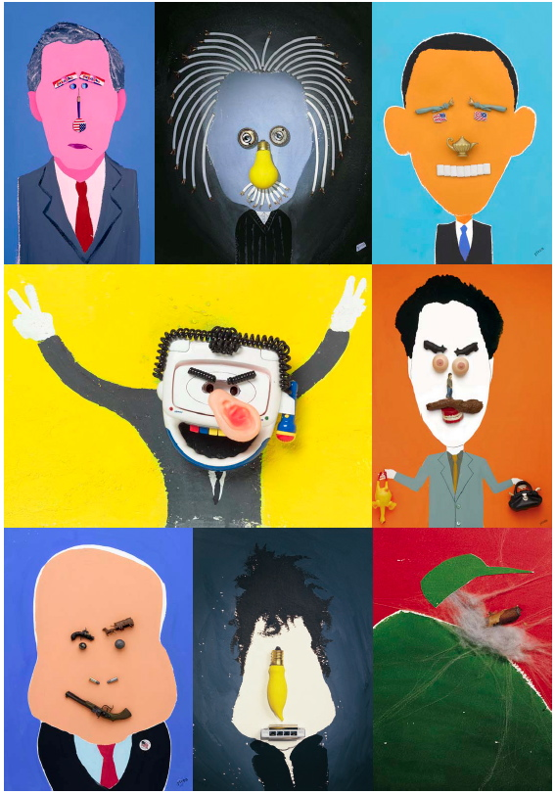
Celebrity
Caricature
Assemblage
Principles of Visual Design LCC 2720
Instructor: Brian Schrank

Slide 2
Lecture Overview
Caricatures
Collage
Found Objects
Paint

Slide 3
Lecture Overview
Caricatures
Collage
Found Objects
Paint

Slide 4
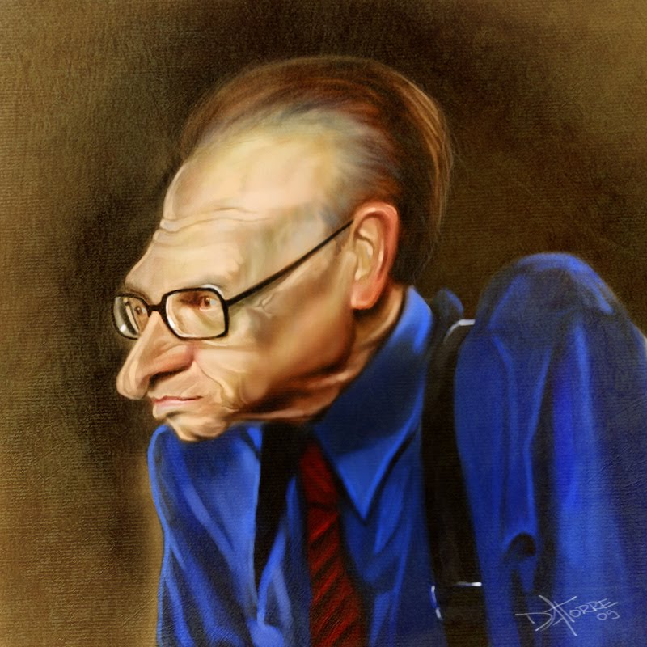
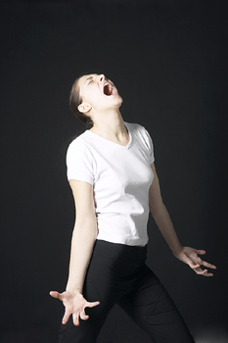
Caricatures

Slide 5
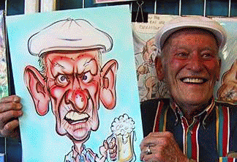
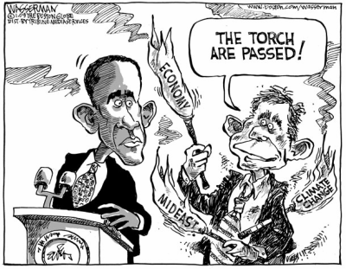
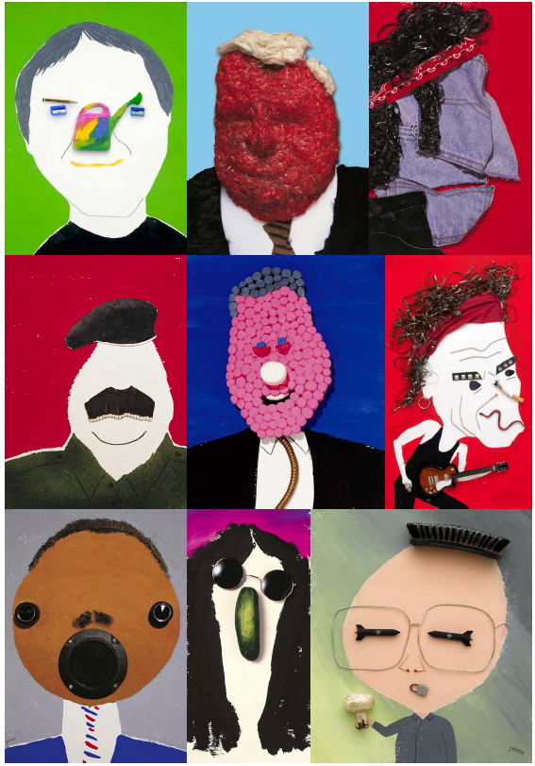
Kinds of Caricatures
Traditional
Political Cartoon
Caricature Assemblage

Slide 6
Kinds of Caricatures
Traditional
Political Cartoon
Caricature Assemblage
Less Detail

Slide 7
How to Caricature
Clarity
Condensation
Exaggeration of a Feature

Slide 8
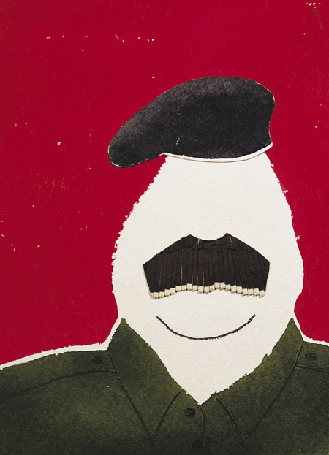



How to Caricature
Clarity
  Simple Yet Descriptive

Slide 9
How to Caricature
Clarity
  Simple Yet Descriptive

Slide 10
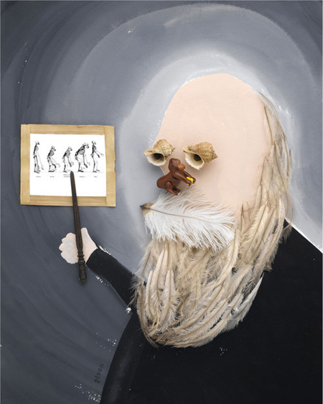
How to Caricature
Clarity
Condensation
  What defines them?
  What are they known for?
  Where are they from?
  How did they die?
  What makes them unique?

Slide 11
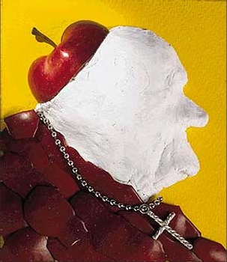
How to Caricature
Clarity
Condensation
  Are they a prickly person?
  Are they a fluid person?
  Are they a squishy person?

Slide 12
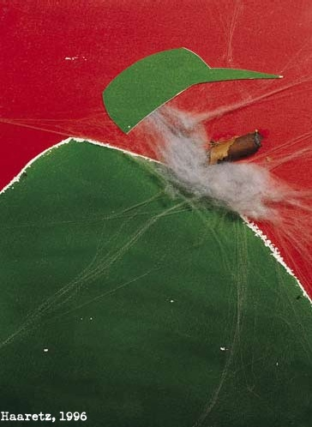
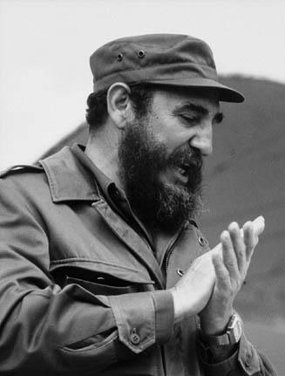
Caricature
Clarity
Condensation
Exaggeration of a Feature
  Body shape
  Stature
  Cult of Personality

Slide 13
Caricature
Clarity
Condensation
Exaggeration of a Feature
  Head shape
  Nose shape
  Phallic - obsession with sex

Slide 14
Caricature
Clarity
Condensation
Exaggeration of a Feature
  Head shape
  Mouth shape
  Media-centric orator

Slide 15
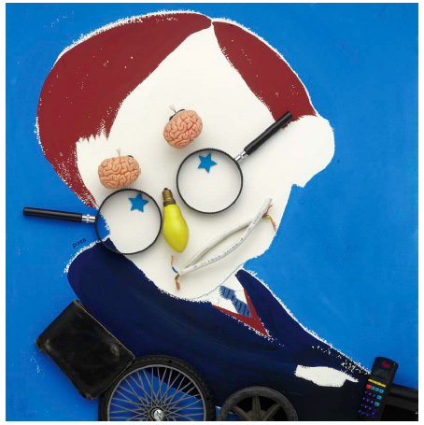
Caricature
Clarity
Condensation
Odd Exaggeration

Slide 16
Caricature
Clarity
Condensation
Odd Exaggeration
???

Slide 17
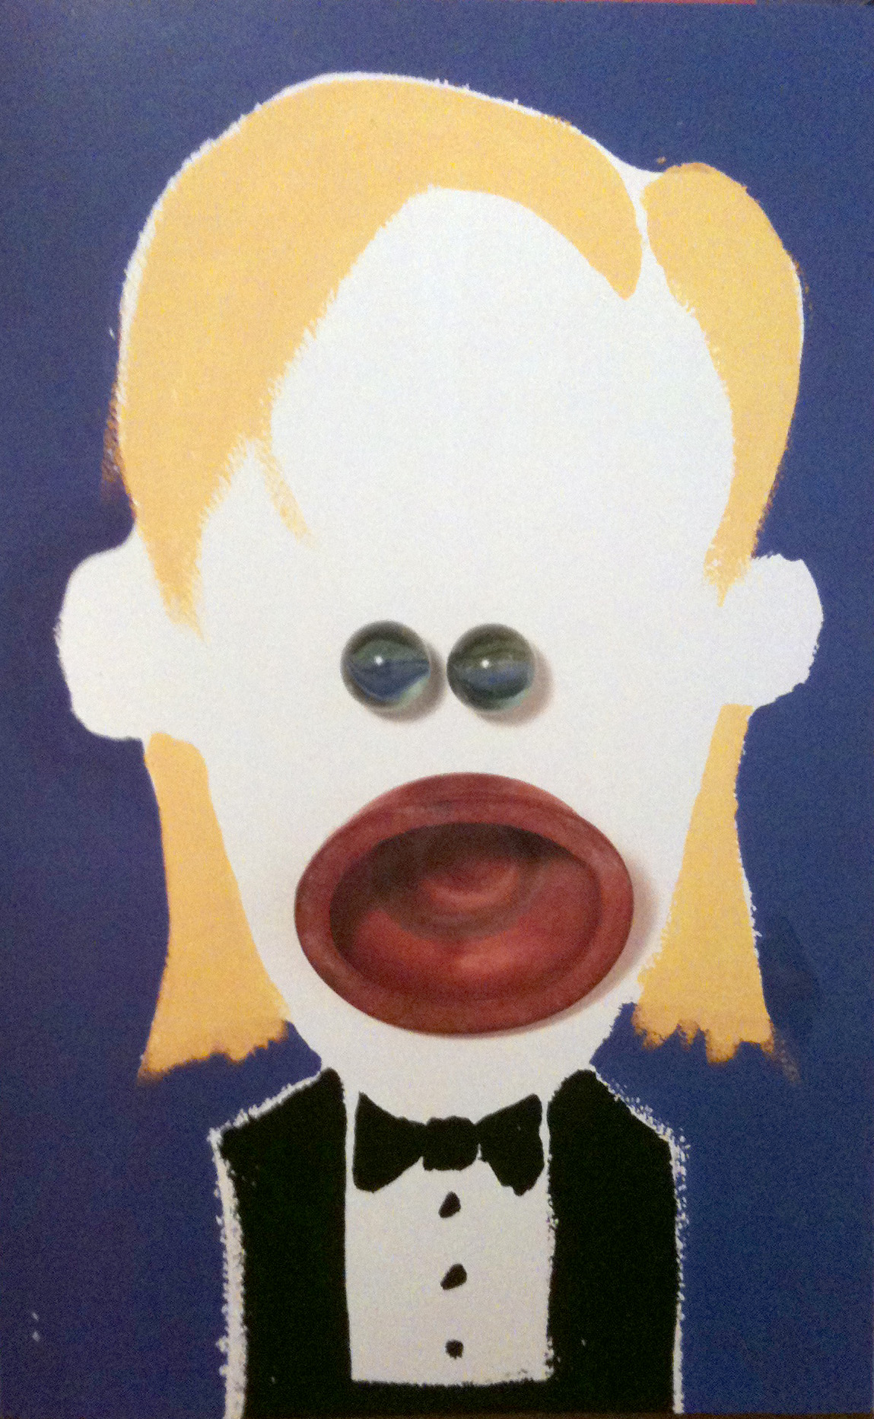
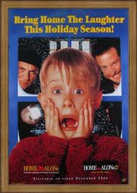
Caricature
Clarity
Condensation
Odd Exaggeration

Slide 18
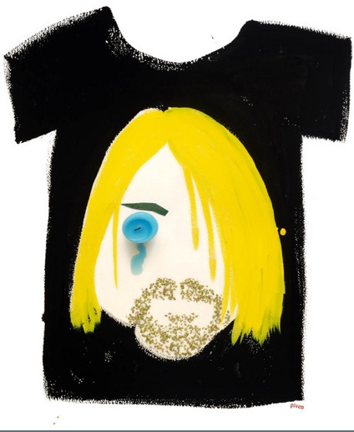
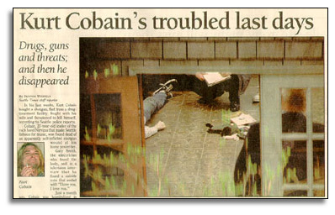
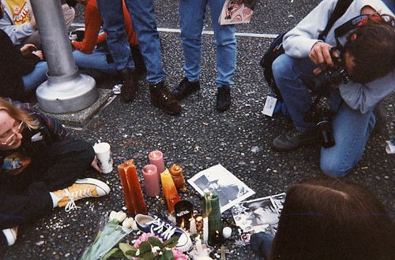
Caricature
Clarity
Condensation
Odd Exaggeration

Slide 19
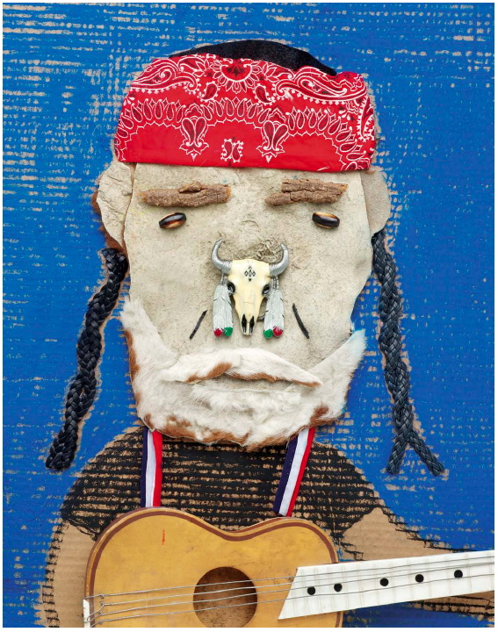
Background as Object
Clarity
Condensation
Odd Exaggeration

Slide 20
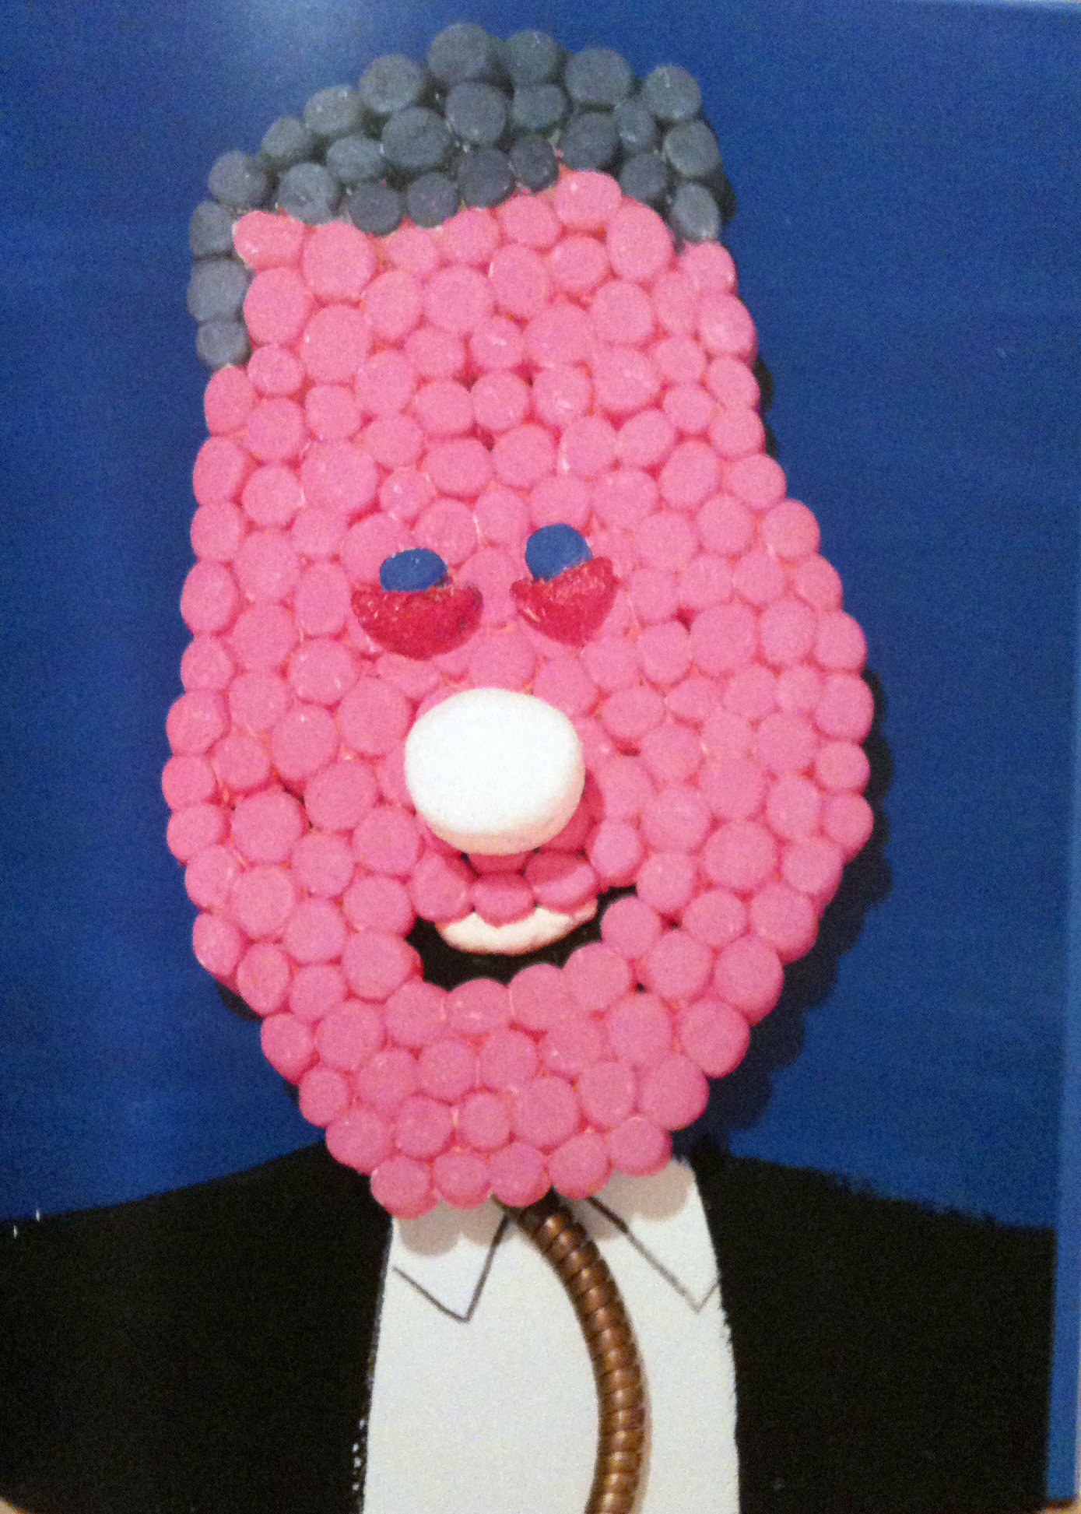
Creative Use of Materials
Clarity
Condensation
Odd Exaggeration

Slide 21
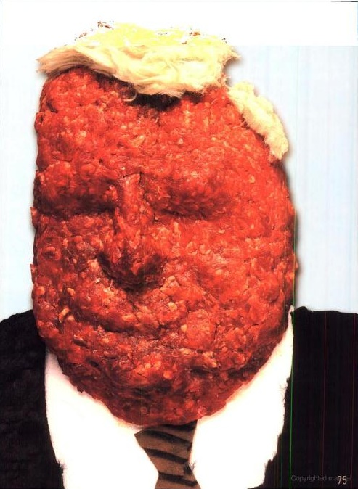
Creative Use of Materials
Clarity
Condensation
Odd Exaggeration

Slide 22
Lecture Overview
Caricatures
Collage
Found Objects
Paint

Slide 23

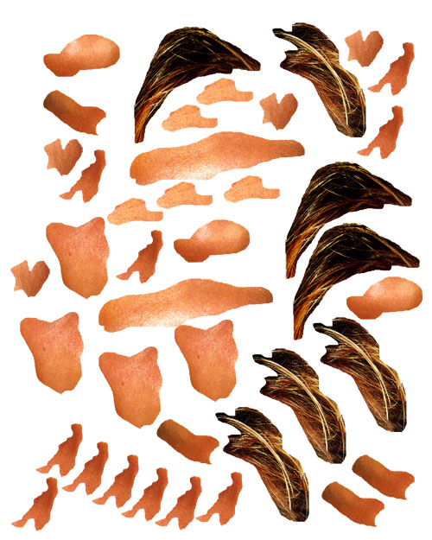
Collage
Collage allows you to easily play with shapes

Slide 24
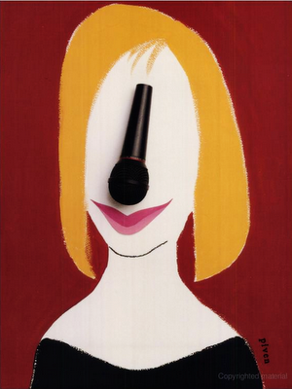
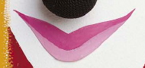
Collage
Collage allows you to easily play with shapes
Paint a piece of paper
  cut out of it paper noses, mouths, hats, eye, etc.

Slide 25
Collage
Collage allows you to easily play with shapes
Paint a piece of paper
  cut out of it paper noses, mouths, hats, eye, etc.

Slide 26
Collage
Collage allows you to easily play with shapes
Paint a piece of paper
  cut out of it paper noses, mouths, hats, eye, etc.

Slide 27
Lecture Overview
Caricatures
Collage
Found Objects
Paint

Slide 28
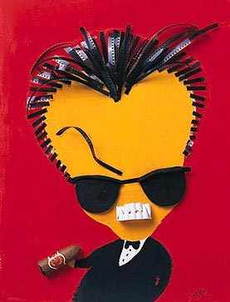
Found Objects
Literal Meaning
Visual Shape

Slide 29
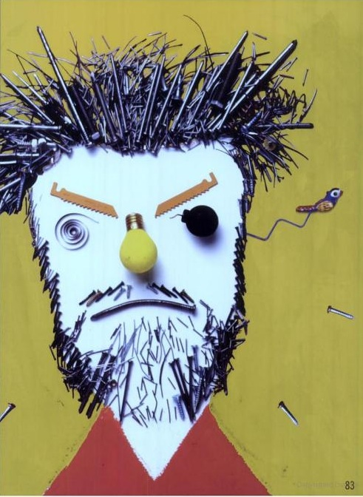
Found Objects
Literal Meaning
Visual Shape

Slide 30
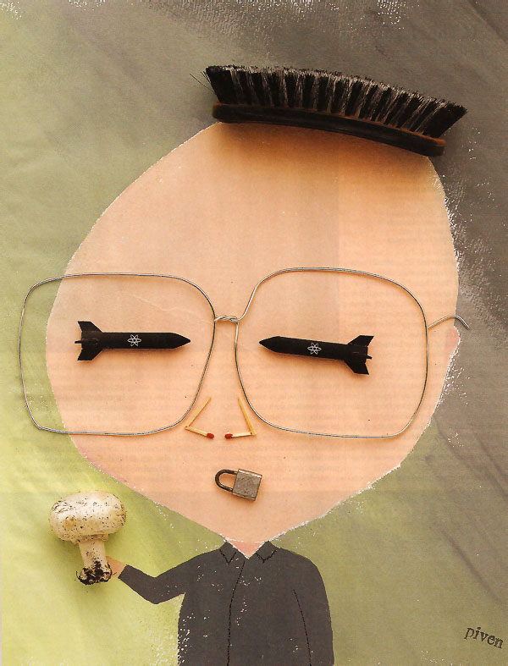
Found Objects
Literal Meaning
Visual Shape

Slide 31
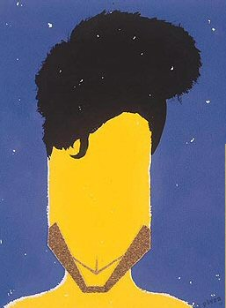
Creative Use of Object
Literal Meaning
Visual Shape
  iconic facial hair
  chiseled look

Slide 32
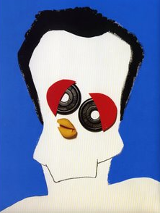
Found Objects
Literal Meaning dominant
Visual Shape subordinate
  exaggerated

Slide 33
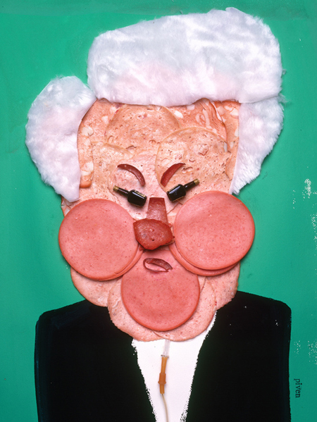
Found Objects
Visual Shape dominant
Literal Meaning subordinate
  exaggerated

Slide 34
Brainstorm Break!!!

Slide 35
Found Object Brainstorm!
Brainstorm up some objects that would both
VISUALLY and LITERALLY represent:
  Don Draper
  Snooki
  Johnny Knoxville
  Sarah Palin
  Deepak Chopra
  Glenn Beck

Slide 36
Lecture Overview
Caricatures
Collage
Found Objects
Paint

Slide 37
Paints to Use
Water-Based
  Acrylic
  Watercolor
  Gouache
Oil-Based
  Oil Paint
    DO NOT USE

Slide 38
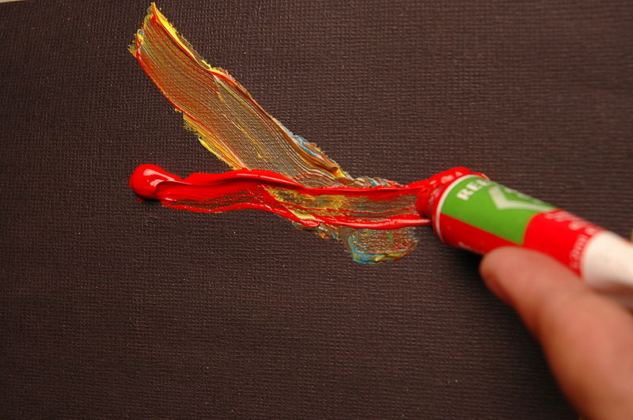
Acrylic Paint
Synthetic (dries fast)

Slide 39
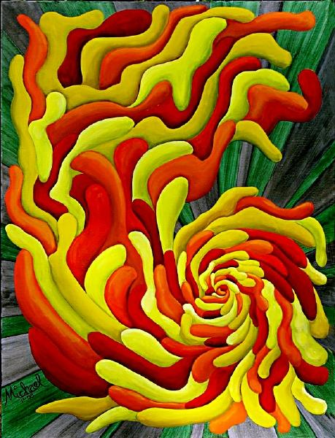
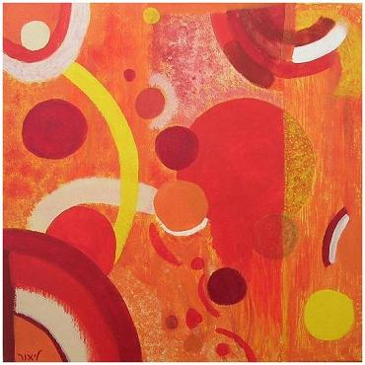
Acrylic Paint
Synthetic (dries fast)
Opaque layering

Slide 40
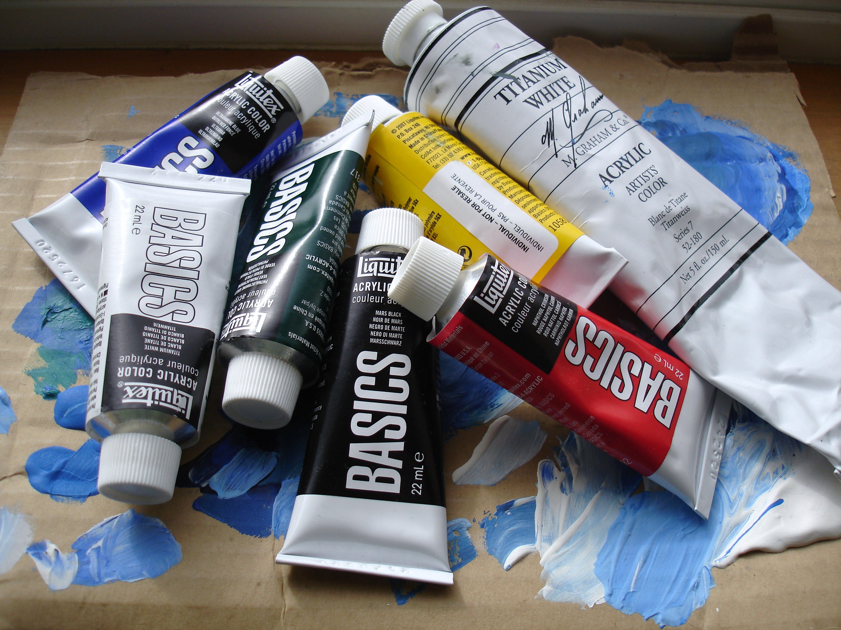
Acrylic Paint
Synthetic (dries fast)
Opaque layering
Cheap

Slide 41
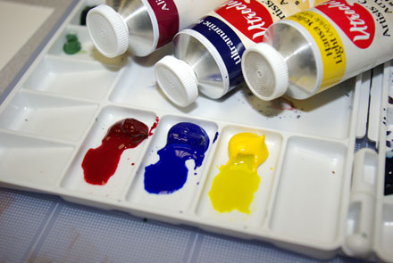
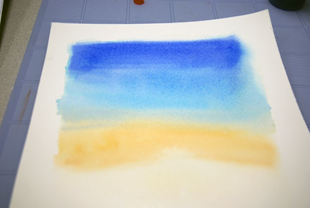
Acrylic Paint
Dilute with water to keep it from drying fast

Slide 42
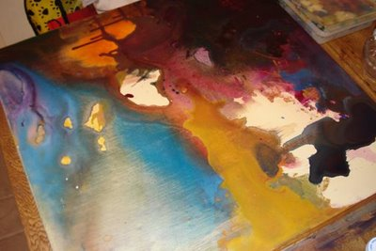
Acrylic Paint
Dilute with water to get nice washes

Slide 43
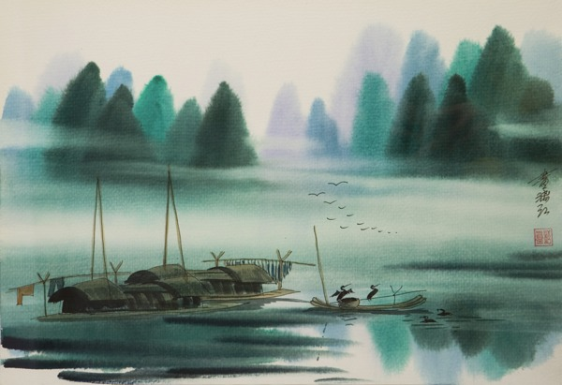
Watercolor Paint
Natural (dries slower)

Slide 44
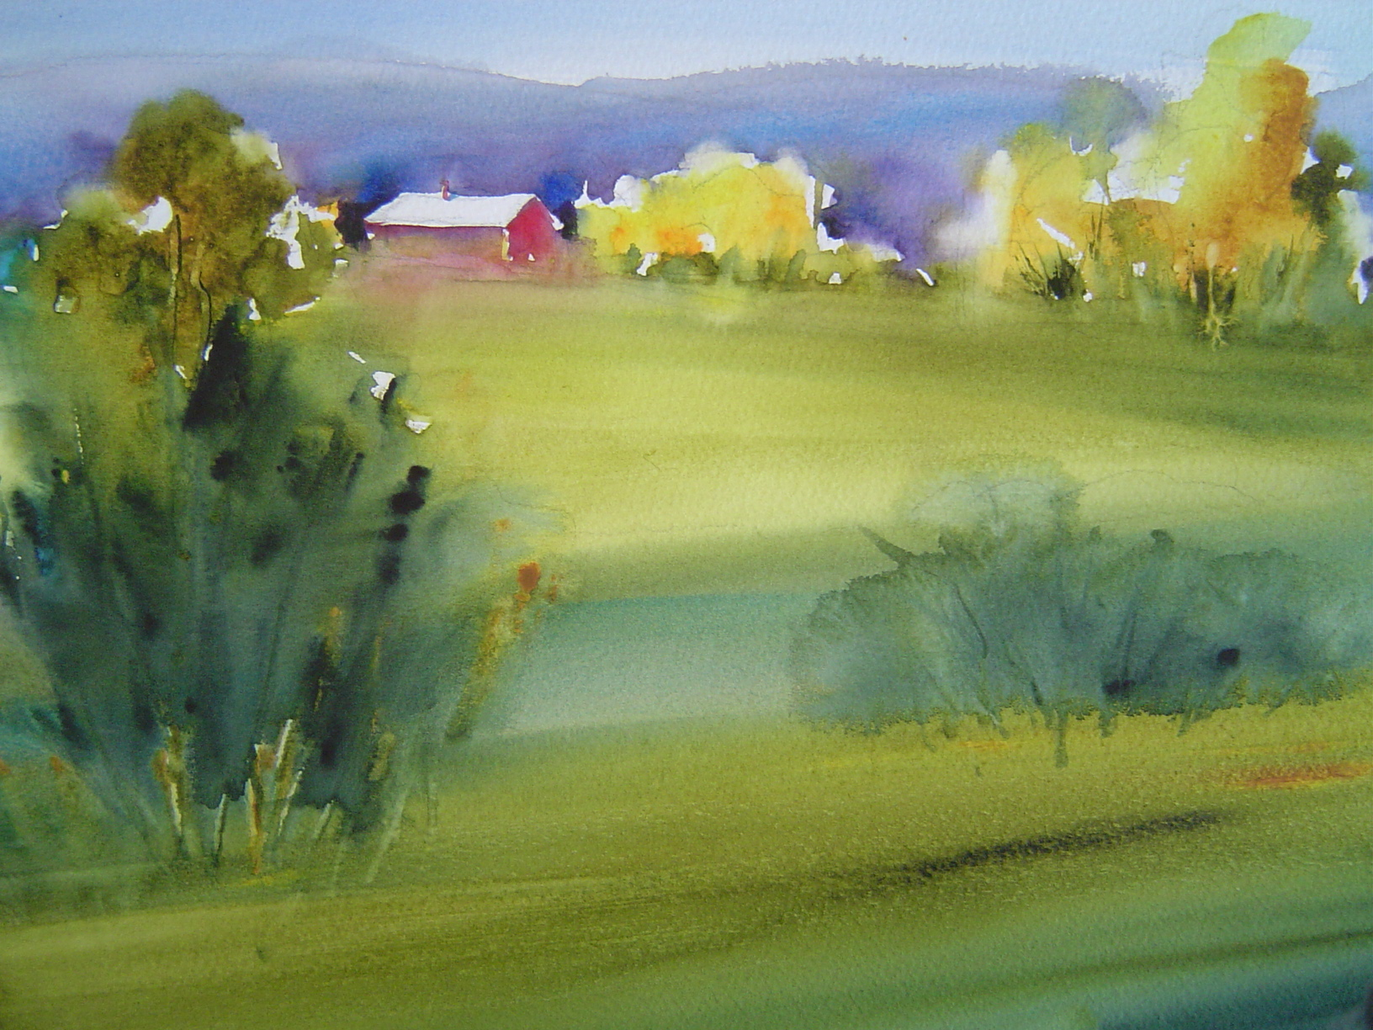
Watercolor Paint
Natural (dries slower)
Can re-wet and re-work

Slide 45
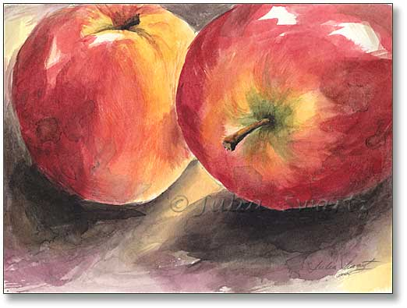
Watercolor Paint
Natural (dries slower)
Can re-wet and re-work
Easier to do transparent layering than acrylic

Slide 46
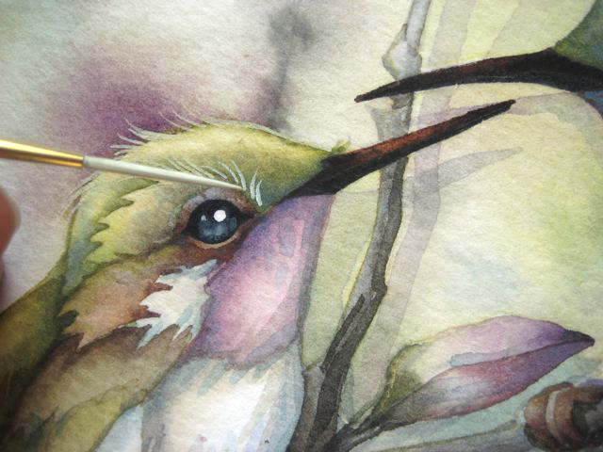
Gouache
Natural (dries slower)

Slide 47
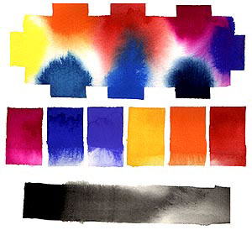
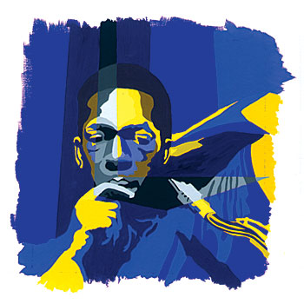
Gouache
Natural (dries slower)
Super vibrant, colors radiate

Slide 48
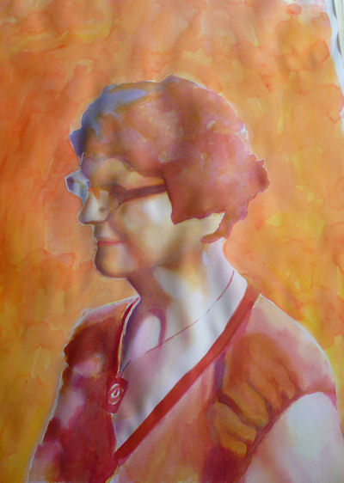
Gouache
Natural (dries slower)
Super vibrant, colors radiate
Can re-wet and re-work

Slide 49

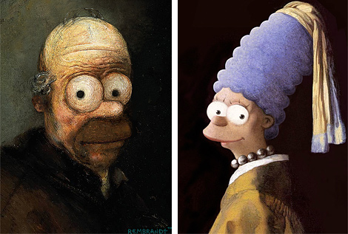
Oil Paint
Natural, but dries very slow

Slide 50
Oil Paint
Natural, but dries very slow

Slide 51
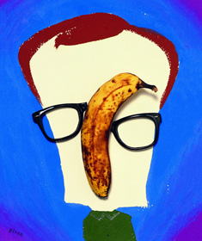
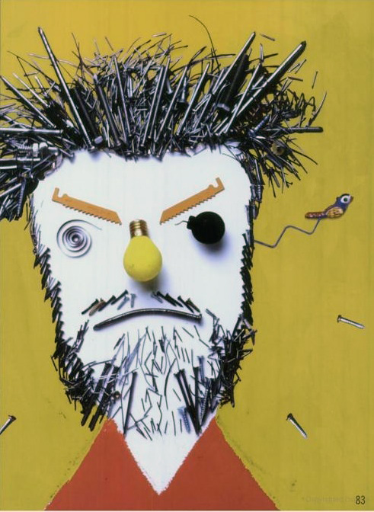
Questions?

